Slide 1
Global natural gas markets: the current state and prospects Diversification is our feature, Innovation is at the core of our cooperation, Investment is our instrument for Market Stability
Yury P. Sentyurin, PhD.
Secretary General of the GECF
Gas Symposium
Port of Spain, Trinidad and Tobago
13 November 2018

Slide 2
Natural gas in the global energy mix (22% now to 26% by 2040)
+3,685 Mtoe
(+26%)
Source: GECF Secretariat based on data from the GECF GGM

Slide 3

The G20 Communique on Natural Gas
“
We recognise the key role that natural gas currently plays for many G20 countries, and its potential to expand significantly over the coming decades, supporting transitions towards lower emission energy systems. We will endeavour to improve the functioning, transparency and competitiveness of gas markets, with a strategic view of the supply chain -including Liquefied Natural Gas (LNG) and storage facilities -at a global level. We will encourage an expanded dialogue with relevant international organisations on more effective and flexible use of natural gas.
”
G20 Energy Ministers Communique
15 June 2018, Bariloche, Argentina

Slide 4

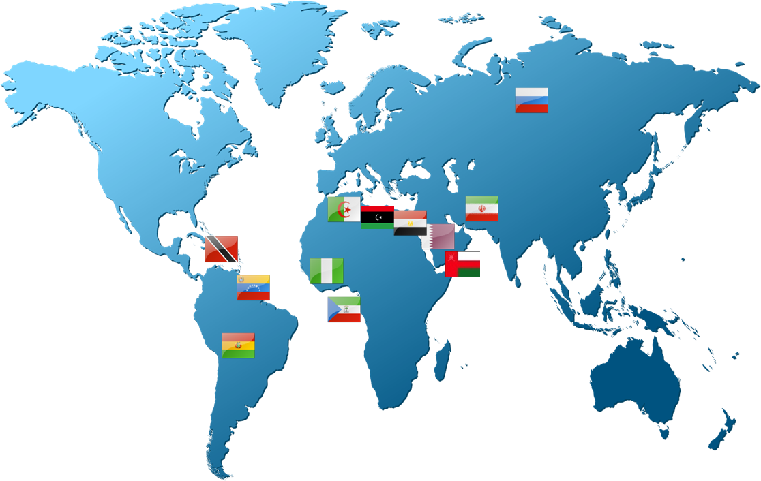

















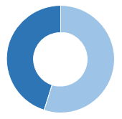
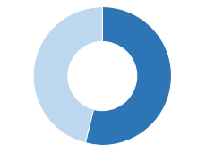
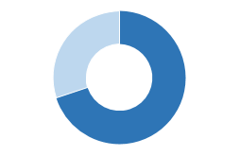
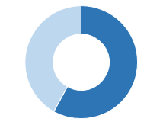
Gas Exporting Countries Forum (GECF)
MEMBERS
OBSERVERS
Algeria
Azerbaijan
Bolivia
Iraq
Egypt
Kazakhstan
Equatorial
Guinea
Norway
Iran
Oman
Libya
Peru
Nigeria
Qatar
Russia
Trinidad
and Tobago
70%
45%
64%
54%
United Arab
Emirates
Venezuela
Gas Reserves
(144 Tcm)
Gas Production
(1,650 Bcm)
Pipeline Gas Exports
(447 Bcm)
LNG Exports
(156 Mt)

Slide 5
Trinidad and Tobago: A distinguished founding Member of the GECF
2017 Gross Natural Gas Production (bcm)
2017 LNG Exports (bcm)
In 2017, Trinidad and Tobago was the fourth largest LNG exporter and the twelfth largest producer of natural gas among all GECF Member Countries
Source: GECF Annual Statistical Bulletin

Slide 6
Current Global Natural Gas Market Drivers
Robust growth of the global economy (3.7% in 2017);
Changes in energy policy in a number of countries;
Rising unconventional gas production (over 800 Bcm per year);
Growing global gas consumption (4% in 2017);
Increasing gas trade (1,134 Bcm, or 31% of consumption, in 2017).

Slide 7
Global natural gas demand to increase by 46%, from 3709 bcm in 2017 to 5427 bcm in 2040
Natural gas demand by region in 2017 and 2040 (%)
Global natural gas demand by region (bcm)
Source: GECF Secretariat based on data from the GECF GGM

Slide 8
Energy Policy Map (Developments Since January 2018)
Europe
France
Postponing target to decrease nuclear share
Decision to phase out coal power plants by 2021
Belgium
The government’s decision to subsidize new electricity capacity
EU
Approval of 32% of renewables target by 2030
Approval of the ETS reform
Denmark
To build 2400 MW of new wind capacity by 2030
The Netherlands
To phase out coal power plants by 2030
To phase out Groningen gas production by 2030
UK
New measures to support shale gas production
North America
Asia
United States
EPA’s new regualtions to cut power plants emission
US administration reserves fuel economy targets
The US government’s decision to impose tariffs on imported goods from China
New bill aiming to speed up LNG project approval process
Canada
New measures to phase out coal power plants
Mexico
Sets the target of 50% clean energy share in power generation by 2034
India:
New restrictions on biofuel import
Implementing policies to incentivize development of unconventional resources
Decision to split GAIL by March 2019
China:
Imposing tariffs on imported LNG from the US
New regulation on wholesale residential gas price
Giving third-party access to oil and gas infrastructure
Indonesia
Mandates 20% of biofuel content in diesel fuel mix
South Korea
To increase tax on coal power plants
New policies to support offshore wind
13th natural gas long term plan
Japan
New version of Basic Energy Plan
Decision to cut feed-in-tariffs for solar plants
Africa
South America
South Africa:
Decision to add 9.6 GW nuclear capacity by 2030.
To introduce carbon tax as of January 2019
Angola
New policy to decrease tax on development of oil fields
Argentina
New decision to Increase electricity prices by 24%
Brazil
10% CO2 emission cut by 2028
Pacific
Australia
The country gives up national energy guarantee objectives
Source of Information: Enerdata
Energy Policies are fundamental drivers of energy demand and supply.

Slide 9
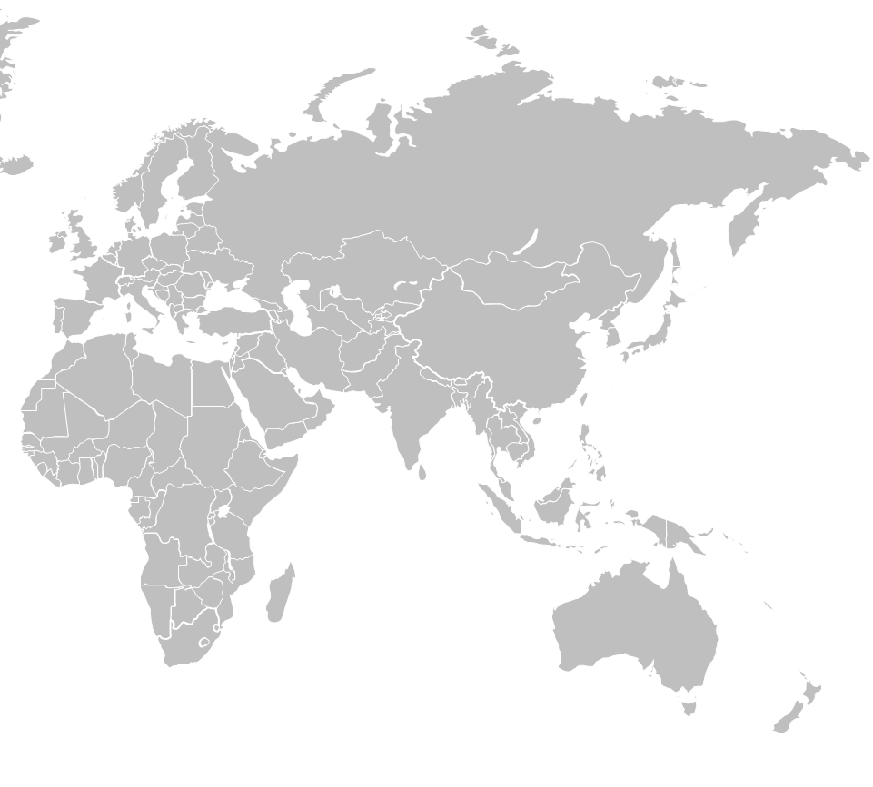
GECF’s new LNG project: expected FIDs
Qatar LNG Expansion, increase in liquefaction capacity from 77 mtpa to 110 mtpa by end of 2023, FID expected in 2019
Nigerian LNG (NLNG), T7+, 8mtpa, FID expected in 2018
Fortuna FLNG, 2.2-2.5 mtpa, FID expected in 2018/19
Baltic LNG, 10 mtpa, FID expected in 2019
Vysotosk LNG Train 2, 0.66-0.8 mtpa, FID possible in 2018-2019
Arctic LNG Train 2, 19.8 mtpa, FID expected in 2019
Far East LNG, 6 mtpa, FID expected in 2019
Sakhalin-2 Train , 5.4 mtpa, FID expected in early 2019

Slide 10
Concluding Remarks
Natural gas is an attractive combination of environmental sustainability and economic viability;
Natural gas is considered to be the destination fuel and not the transition fuel;
Shale gas development will eventually contribute to increasing the time period when gas will remain a viable energy source;
GECF countries invest a lot in gas infrastructure;
GECF countries are committed to ensuring security of gas supply and will remain secure and reliable gas suppliers to the global market.
GECF will continue its advocacy campaign for natural gas as the fuel of choice.

Slide 11
Thank you for your attention!
More information is available at: www.gecf.org

